Slide 1

UNLOCKING HIDDEN VALUE:
LIFE SETTLEMENTS
FOR HIGH-NET-WORTH CLIENTS
AND
BUSINESS OWNERS
LAKE COUNTY ESTATE PLANNING COUNCIL
NOVEMBER 6, 2025

Slide 2
The Benefits of Life Settlement
Life insurance provides financial solutions to meet various needs of businesses and families. Over time, however, needs change. Policies may fail to meet expectations or may no longer be needed.
A life settlement offers policyowners the opportunity to sell their policy for significantly more than the cash value offered by the insurance carrier.
A life settlement is the sale of an existing life insurance policy for more than the policy’s cash value but less than the death benefit.
The purchaser assumes ongoing premium payments and receives the death benefit upon the death of the insured. In many cases, policyowners can choose to retain a portion of the policy’s death benefit in lieu of, or in addition to, a cash payment.
Not for distribution, copying or unauthorized use.

Slide 3
Consumer Benefits
It is estimated that more than $600 billion of life insurance is surrendered or permitted to lapse each year⁽¹⁾ – more than $100 billion of which is by seniors.⁽²⁾ Further, nearly 90% of all Universal Life policies never result in a death claim.⁽³⁾
Over 95% of Term Life policies never result in a death claim. If your client is considering a lapse, a life settlement can help recoup premiums rather than walking away empty handed.
A surrender essentially is a sale of the policy back to the insurance company for cash value.
Multiple studies show that, on average, sellers receive 4X the policy’s cash surrender value in addition to decreased monthly expenditures for policy premiums.⁽⁴⁾
⁽¹⁾Source: 2022 ACLI Life Insurers Fact Book
⁽²⁾Source: LISA Institutional Investors Conference Study
⁽³⁾Source: Olin Business School and Wharton School Lapse-Based Insurance study
⁽⁴⁾Source: LISA Annual Survey, London Business School study and U.S. GAO Retirement Security study
Not for distribution, copying or unauthorized use.

Slide 4
Today’s Focus
The Secondary Market Today
Next Generation Planning Guide
Find Hidden Value and Enhanced Cash Value (ECV)
Term Settlements, Retained Death Benefit, and Simplified Settlements
Education and Due Diligence
State Regulation
Mitigating Fiduciary Liability
Not for distribution, copying or unauthorized use.

Slide 5
THE SECONDARY MARKET
TODAY
Not for distribution, copying or unauthorized use.

Slide 6
The Secondary Market Today
Push towards institutional capital
Life expectancies up to 20 years
Additional options: term settlements, Retained Death Benefit and Simplified Settlements®
Not for distribution, copying or unauthorized use.

Slide 7
Increased Consumer Demand
Policy is underperforming or unaffordable
Estate tax laws have changed
Rise in longevity risk
Opportunities with convertible term policies
Life settlement awareness is rising among consumers
Approximately 20% of seniors are aware that a life settlement is an option
Not for distribution, copying or unauthorized use.

Slide 8
Tax Cuts and Job Act (2017)/One Big Beautiful Bill Act (2025)
TCJA and OBBBA impacts upon life settlement transactions.
TCJA doubled the estate tax exemption, which made it less necessary for many wealth families to keep life insurance policies.
Many policies purchased for estate tax purposes must be reviewed. Some of these policies, including second-to-die policies may no longer be necessary or desired.
Another provision changed how life settlements are taxed, making life settlements more favorable for sellers and making the tax due on the proceeds from a life settlement easier to calculate.
Not for distribution, copying or unauthorized use.

Slide 9
NEXT GENERATION
PLANNING
GUIDE
Not for distribution, copying or unauthorized use.

Slide 10
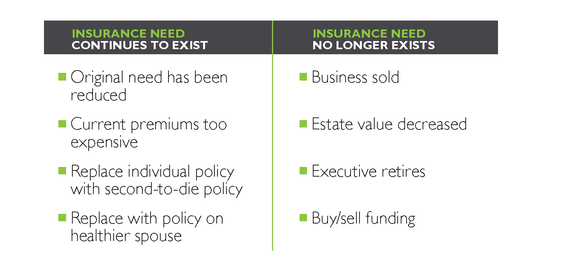
Policy Valuation
Determining your clients’ needs
Not for distribution, copying or unauthorized use.

Slide 11
Policy Valuation
What to look for
Insured age 65 and over
Underperforming or unneeded policy
Considering a change in insurance
Face value of $100,000 or more
Not for distribution, copying or unauthorized use.

Slide 12
Policy Valuation
Determining market value
Insured age 65 and over
Underwriting/ life
expectancy
Cost of policy
Cash value and access
Policy Type
Premium flexibility
Riders (age 100,
ROP riders)
Carrier rating
Not for distribution, copying or unauthorized use.

Slide 13
FIND HIDDEN
VALUE
Life settlements give your clients
access to the market value of their
life insurance policies.
Not for distribution, copying or unauthorized use.

Slide 14
Life Settlements
Ideal candidates
Qualifying policyowners with unneeded or underperforming policies
Overview
More than an exit strategy
Efficient management of underperforming policies
Not for distribution, copying or unauthorized use.

Slide 15
Life Settlements
INSURED Male age 79 FACE AMOUNT $1,500,000
POLICY Universal Life CASH VALUE $0
Coventry First provided the policyowner
with $196,000.
This case example is only intended for insurance and financial planning professionals, and is not for consumers or owners of individual life insurance policies. The details stated herein may be approximations and were reported to Coventry by the policyowner’s representative and are being presented by Coventry without independent verification by the policyowner. ©2024 Coventry First LLC. All Rights Reserved.
07.13 f
Not for distribution, copying or unauthorized use.

Slide 16
DISCOVER
TERM
SETTLEMENTS
Not for distribution, copying or unauthorized use.

Slide 17
Term Settlements
Overview
Eliminate ongoing premiums
Recover prior premium outlay
Bridge to permanent coverage
Not for distribution, copying or unauthorized use.

Slide 18
Life Settlements
INSURED Male age 69 FACE AMOUNT $4,000,000
POLICY Term CASH VALUE $0
With the 20-year term coming to an end, the trustee was planning to let the policy lapse. Coventry paid $285,000 for a policy with zero cash value.
This case example is only intended for insurance and financial planning professionals, and is not for consumers or owners of individual life insurance policies. The details stated herein may be approximations and were reported to Coventry by the policyowner’s representative and are being presented by Coventry without independent verification by the policyowner. ©2024 Coventry First LLC. All Rights Reserved.
7.13 d
Not for distribution, copying or unauthorized use.

Slide 19
DON’T
SURRENDER
Retained death benefit transactions help your clients keep
a portion of their insurance with
no future premiums.
Not for distribution, copying or unauthorized use.

Slide 20
Retained Death Benefit
Overview
Maintain a portion of insurance with no future premium payments
Compliment to replacement of coverage
Redeployment of capital
Not for distribution, copying or unauthorized use.

Slide 21
Retained Death Benefit
INSURED Female age 70 FACE AMOUNT $1,500,000
POLICY Universal Life CASH VALUE $ 116,400
RDB made it possible for the policyowner to retain $500,000 in death benefit with no future premium obligations for one of her two policies. Combined with the other policy, she kept a total of $2 million in coverage while reducing overall premium outlay.
This case example is only intended for insurance and financial planning professionals, and is not for consumers or owners of individual life insurance policies. The details stated herein may be approximations and were reported to Coventry by the policyowner’s representative and are being presented by Coventry without independent verification by the policyowner. ©2024 Coventry First LLC. All Rights Reserved.
07.13 j
Not for distribution, copying or unauthorized use.

Slide 22
Retained Death Benefit
INSURED Male age 73 FACE AMOUNT $3,000,000
POLICY Universal Life CASH VALUE $ 0
The policyowner retained a decreasing death benefit with no future premium obligations, beginning at $2.1 million for the first 5 years, $1.3 million for the following 5 years and continuing at $1 million thereafter.
This case example is only intended for insurance and financial planning professionals, and is not for consumers or owners of individual life insurance policies. The details stated herein may be approximations and were reported to Coventry by the policyowner’s representative and are being presented by Coventry without independent verification by the policyowner. ©2024 Coventry First LLC. All Rights Reserved.
07.13 m
Not for distribution, copying or unauthorized use.

Slide 23
SMALL
HAS BIG APPEAL
Now smaller policies can qualify thanks to the streamlined process of Simplified Settlements.
Not for distribution, copying or unauthorized use.

Slide 24
Simplified Settlements
Ideal candidates
Qualifying policyowners with policies of $100,000 – $500,000 (select policies up to $1 million)
Ages 65-90
Not for distribution, copying or unauthorized use.

Slide 25
Simplified Settlements
INSURED Male age 69 FACE AMOUNT $300,000
POLICY Term CASH VALUE $ 0
Coventry First provided the policyowner with $7,500 for a policy that had no surrender value.
This case example is only intended for insurance and financial planning professionals, and is not for consumers or owners of individual life insurance policies. The details stated herein may be approximations and were reported to Coventry by the policyowner’s representative and are being presented by Coventry without independent verification by the policyowner. ©2024 Coventry First LLC. All Rights Reserved.
7.13 f
Not for distribution, copying or unauthorized use.

Slide 26
Education and Due Diligence
Funding source considerations
Confidentiality and privacy
Source of investor funds
Proper licensing
Experience and tenure in industry
Not for distribution, copying or unauthorized use.

Slide 27

Market Regulation
¹ New Mexico, Michigan and Delaware regulate viatical settlements only.
Not for distribution, copying or unauthorized use.

Slide 28
Key Provisions of the Illinois Life Settlements Law
Viatical Settlements Act of 2009 (ILCS 159); Illinois Administrative Code, Title 50 (Part 3701)
Licensing Requirements
Mandatory Disclosures
Rescission Rights (at least 30 days from contract execution or 15 days from receipt of proceeds).
Fraudulent Practices
Prohibition of engaging in STOLI practices
Not for distribution, copying or unauthorized use.

Slide 29
Good News vs. Good News
The result of the policy valuation might be that the policy is performing well and should be maintained. Or you may find that the policy is worth far more than you previously thought and your client can benefit from a reallocation of those assets through a life settlement.
In either case, it is a win.
Unlock the fair market value of your client’s life insurance policy;
Uncover new sources of liquidity for your clients;
Provide useful planning options for your clients;
Be a solution to poorly structured or financed policies.
Not for distribution, copying or unauthorized use.

Slide 30
Potential Fiduciary Liability for Failing to Explore a Life Settlement Transaction
Why It Matters
Duty of Care – Advisors, trustees, and fiduciaries must act in the best interest of clients.
Disclosure Obligations – Failing to present life settlement options could result in financial harm to policyholders.
Legal Precedents – Cases like Grill et al. v. Lincoln National Insurance Co. highlight the risks of failing to inform clients about alternatives to policy lapse or surrender.
Not for distribution, copying or unauthorized use.

Slide 31
Potential Fiduciary Liability for Failing to Explore a Life Settlement Transaction
Risk Factors for Fiduciaries
Recommending policy surrender without exploring all available options.
Not conducting a policy valuation before advising on coverage changes.
Ignoring market alternatives when clients face increasing premiums.
Lack of documentation showing that life settlements were considered.
Not for distribution, copying or unauthorized use.

Slide 32
Potential Fiduciary Liability for Failing to Explore a Life Settlement Transaction
Mitigating Fiduciary Risk
Educate clients – Inform policyholders of their right to explore life settlements.
Evaluate Policy Value – Seek market-based appraisals before advising on surrender.
Maintain Documentation – Keep records of discussions regarding settlement options.
Partner with Experts – Work with life settlement professionals to ensure clients receive a fair assessment.
Takeaway:
Fiduciaries who fail to consider life settlements may be exposed to liability. Proper diligence and disclosure are essential fiduciary obligations.
Not for distribution, copying or unauthorized use.

Slide 33


Scott J. Etish, Esq.
Director of Strategic Partnerships
setish@coventry.com
215.836.8349

