Slide 1
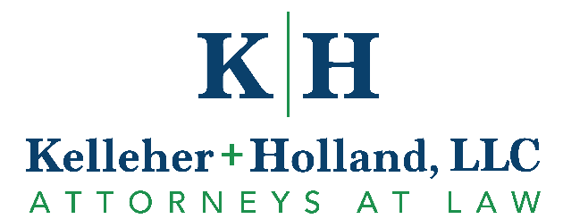
Lake County Estate Planning Council
Upstream Planning and Optimizing Basis Increases
September 5, 2024

Slide 2
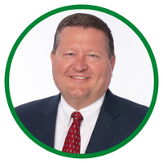
Andrew Kelleher, J.D., CPA, LL.M.
Founding Member
CPA and Advanced Law Degree in Taxation
Concentrates practice in business and trust + estate law for high net worth families
Trust + Will Planning
Corporate Governance
Mergers + Acquisitions
Taxation
Exit + Succession Planning
Asset Protection
Litigation
Commercial Real Estate
2

Slide 3
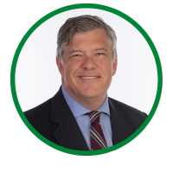
Edwin P. Morrow III, J.D., LL.M (tax), CFP®
Co-Chair of Estate Planning Group
Thought leader in industry behind advanced concepts such as the Optimal Basis Increase Trust and Beneficiary Deemed Owner Trust (BDOT/BIAT®)
Co-Author will Paul Hood and the late Stephan Leimberg of the 21st Edition of the Tools and Techniques of Estate Planning.
Concentrates practice on:
Tax
Trust and Estate Planning
Business Succession
Asset Protection
3

Slide 4
Introduction
Current Federal estate tax and GST exemption: $13,610,000
Current IL exemption: $4,000,000
Risks
Current law – exemption sunsets 12/13/25 to $5,000,000 (adjusted for inflation), 40% tax rate
Senate and House bills – exemption reduction to $3,500,000, 55% tax rate
65% at $93,000,000
10% surcharge on estates over $1 billion
Election results
Professional bandwidth
Use it or Lose it!

Slide 5
Today’s Agenda
Spousal Lifetime Access Trust (SLAT) basics and Installment Sale basics
Improve the ordinary “SLAT” with:
Upstream optimal basis increase planning - Seizing basis opportunity for irrevocable trusts to achieve basis increases at older beneficiary’s death (and at subsequent generation’s)
Keeping the “tax burn” advantage of grantor trust status after death of settlor with Beneficiary Income Accumulation Trust (BIAT®) provisions for the surviving spouse and ultimately descendants
Swap and SURF Planning (Step Up in basis Rescue Financing) – how to get estate tax exclusion while preserving the step up in basis
ILIT Rescue Provisions

Slide 6
Spousal Lifetime Access Trust (SLAT)
Irrevocable Grantor Trust designed to be completed gift outside of estate
Set up by one spouse for primary benefit of the other spouse (secondarily, usually descendants)
Multi-generational and moves wealth to lower generations
Creditor protection
Can be utilized with current $13.61 million exemption and potentially leveraged with discounting of assets and installment sales
Can use annual exclusion (currently $18,000 per donee) with “Crummey” powers, but must be limited to $5,000 for spouse if GST allocated – “gift splitting” is difficult at best and is generally not permitted if a spouse is a beneficiary
Protects future appreciation of assets in SLAT from estate/gift taxes
Permits “swaps”, or substitution of assets – tax-free under current law as long as it’s a grantor trust
6

Slide 7
Installment Sale to Grantor Trust
How It Works
Grantor creates an irrevocable trust of which grantor is the taxpayer (for married couples, a SLAT), typically gifting a substantial “seed gift” (typically at least 10% of amount to be sold)
Grantor then sells assets, commonly (1) discounted LLC units that own various assets such as stock, real estate and/or business interests or (2) Non-voting shares of s-corporation stock, to the grantor trust in exchange for a promissory note
Note charges interest at the Applicable Federal Rate (current Sept 2024 AFR mid-term = 4.02%, long-term 4.37%) and interest payable back to grantor is not taxable event
Unlike a zeroed-out GRAT, it can have minimal payments of interest only in early years
Who Can Benefit Most
Those that have assets with appreciation potential and liquidity/cash flow
7

Slide 8
Installment Sale to Grantor Trust
Sale Benefits
Freezes value of assets for transfer tax purposes at sale price
Any asset appreciation over sale price and interest on note goes to beneficiaries free of estate and gift tax
Can use the same valuation of hard to value assets as gift and avoid multiple annual valuations
Sale Risk
Some income tax uncertainty if grantor passes away during term of promissory note
Less tax benefit to sale if the growth rate on assets sold < applicable federal rate
8

Slide 9
Example
Joe Smith Revocable Living Trust Trustees: Joe and Mary
(Revocable Living Trust)
Mary Smith Revocable Living Trust
Trustees: Mary and Joe
(Revocable Living Trust)
“Assets in Taxable Estate”
“Assets in Taxable Estate”
2 Voting; 96 Non- Voting Units
2 Voting Units
30% discount assumed
$3.5M sale/promissory note at 4.02% AFR (immediate $1.5M out of estate)
Assume 5% year-over-year investment return
Estimated transfer tax benefit after 9 years if assets grow 5% and 8%:
At 5%: $3M x 40% = $1.2M (Federal)
$3M x 50% = $1.5M (IL + Federal)
At 8%: $5.1M x 40% = $2.04M (Federal)
$5.1M x 50% = $2.55M (IL + Federal)
Sale/Transfer of 96 LLC
Non-Voting
Units to SLAT f/b/o Mary
SMITH INVESTMENTS, LLC
Joe, Manager (controls day-to-day management)
Fair market value of assets = $5,000,000 ($3.5M discounted)
4 Voting Units
96 Non-Voting Units
Promissory Note - 9 Year Term
Interest Rate
(4.02% AFR)
9 Annual Payments and a Balloon payment in Year 9
Joe Smith 2024 Irrevocable Trust
(Grantor Trust – Income Taxed to Joe)
Receives 96 Non-Voting Units
Trustee: Mary
Trustee Appointer/Remover: Joe
Primary Beneficiary: Mary (Income & Principal)
Secondary Beneficiaries: Children
Gift of Cash
“Out of Taxable Estate”
Kelleher + Holland, LLC Copyright 2024
9

Slide 10
Improve the Ordinary SLAT!
Upstream Planning
If spouses have older/ill relatives or close loved ones, add them as a discretionary beneficiary as well, and grant them a formula general power of appointment to soak up their step up in basis coupon (applicable exclusion amount)
When older relative dies, assets are included in their estate and cause the trust to get a step up in basis
This is capped in various ways so that inclusion is limited to amount not causing state or federal estate tax (state tax depends on state of residency of the relative)
Leverage can be used (e.g. an LLC owning $6 million of property with $3 million of loans and $1 million of basis may be worth $3 million net, but if included in parent’s estate, the basis becomes $6 million due to debt)
10

Slide 11
Improve the Ordinary SLAT!
BDOT Planning
Due to the “tax burn” and benefits of being a grantor trust, 98% of irrevocable grantor trusts (perhaps 99% for SLATs) are grantor trusts taxed to grantor for income tax purposes
At the grantor’s death, the trust becomes its own taxpayer, with various disadvantages (filing its own return, loss of some deductions/exclusions, 179 expensing, highly compressed tax brackets that may double or triple tax)
This can be avoided by making it a BIAT® (Beneficiary Income Accumulation Trust), a trademarked term for K+H’s proprietary, flexible and protective version of a beneficiary deemed owner trust (BDOT)
This enables taxation to shift to the primary beneficiary (e.g. spouse, then children), avoiding the above issues and allowing trust to grow tax-free
11

Slide 12
Improve the Ordinary SLAT!
Swap and SURF Planning (Step Up in basis Rescue Financing)
The main drawback to all IGTs is that, while growth is excluded from the taxable estate, the assets excluded (probably) do not get a step up in basis at death
Property drafted IGTs and SLATs will permit a tax-free substitution of assets by the grantor. If done before death, the grantor can take back the low basis assets in the trust and put cash into the trust, and die with the low basis assets for step up
This is great conservative planning, but the problem is that most wealthy individuals got that way by NOT investing heavy in cash, and they don’t have cash equivalent or high basis assets to swap into the trust (using a note is risky)
Ideally, a line of credit is established and an agreement approved with lender to “follow the money” for collateral – if cash is swapped before death, the low basis assets get a step up in basis and can save the family millions in capital gains tax!
12

Slide 13
Improve the Ordinary SLAT!
ILIT Rescues – An Important Back Up Plan to Add to SLATs
In many cases for larger estates and business succession/equalization cases, annual premiums for life insurance in ILITs can easily exceed annual exclusion gift amounts
Recent Congressional proposals limit Crummey annual exclusion gifting as well as the applicable exclusion amount (back to $3.5 million???)
If this passes, how would you then fund larger ILITs? Loans involve some tax risk
Make sure that your SLATs permit distributions and loans to ILITs! Remember that a trust can be a beneficiary of another trust. This enables distributions from the SLAT to pay premiums and continue ILIT insurance coverage
13

Slide 14
Conclusions
SLATs are a powerful asset protection and estate tax savings tool. How much in estate tax savings depends on state and federal law that we cannot predict, but many believe with some justification that big changes are likely on the federal level and it may be “use it or lose it”
If family members rather than bank/trust company or professionals are used as trustees, make sure to consult legal and tax counsel more often to avoid amateur administration undermining SLAT tax and asset protection benefits
Consider all of the flexible provisions discussed herein to add more ability to adapt to changes in family situation, state trust law and state and federal income and transfer tax law
14

Slide 15
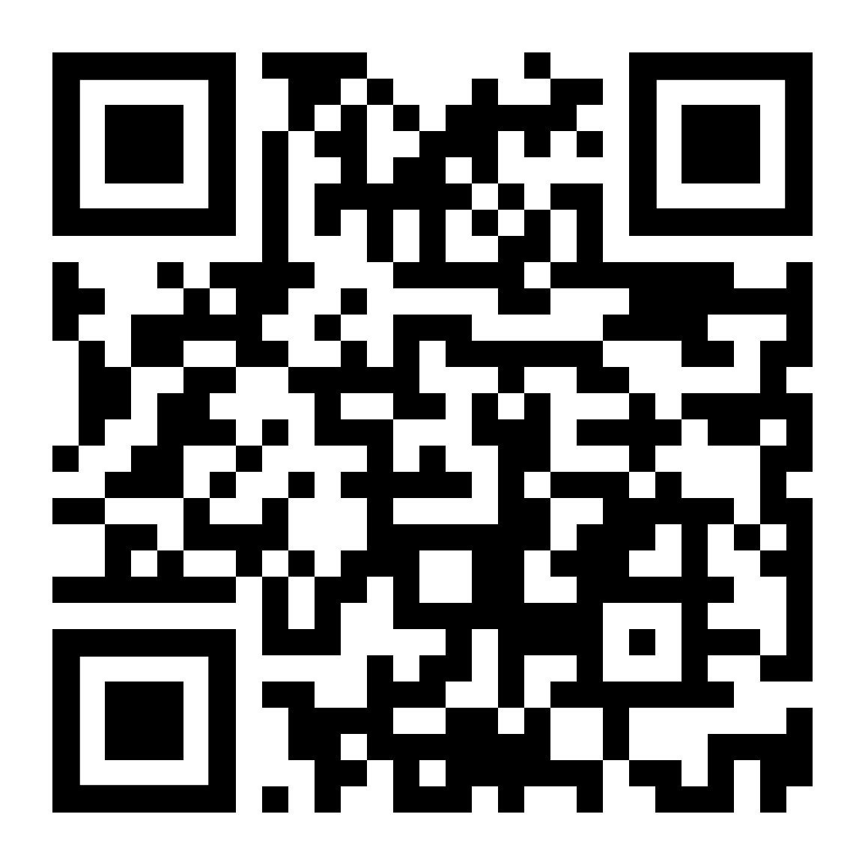
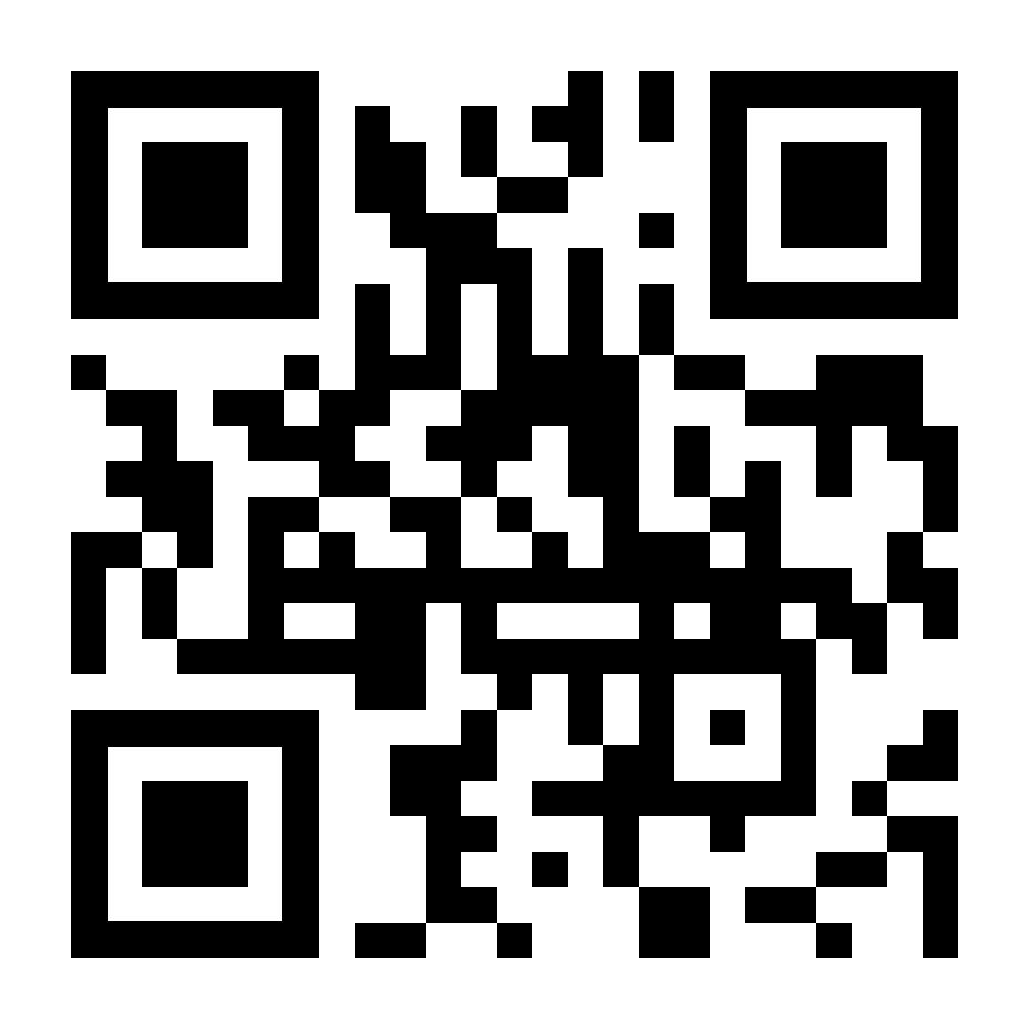
Final Q&A – thank you
Andrew Kelleher
847-682-5367
akelleher@kelleherholland.com
Ed Morrow
847-713-1378
emorrow@kelleherholland.com
This presentation has been prepared for the general information of clients and friends of the firm. It is not intended to provide legal advice with respect to any specific matter. Under rules applicable to the professional conduct of attorneys in various jurisdictions, it may be considered attorney advertising material. Kelleher + Holland, LLC Copyright 2024
15

