Slide 1
Not all Trusts are Created Equal -Proactive Estate Planning Strategies to Minimize Estate & Income Tax
Lake County Estate Planning Council
May 1, 2025

Slide 2
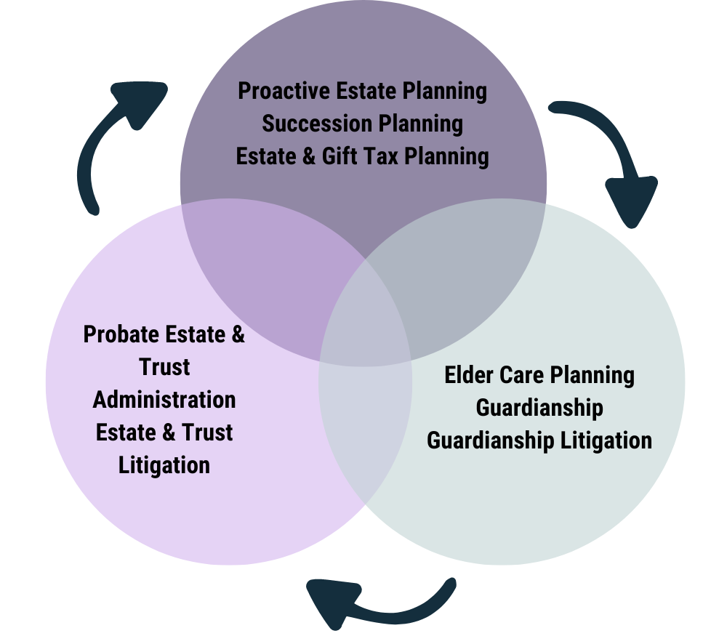
Chuhak & Tecson, P.C. Private Wealth Services

Slide 3
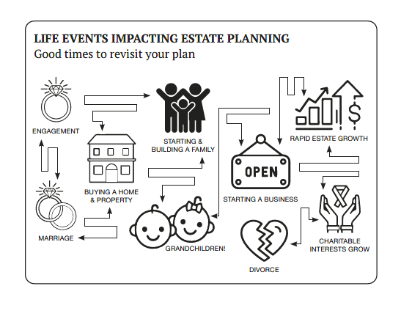
Private Wealth Services

Slide 4
Estate Planning & Asset Protection
Not all Trusts are Created Equal -Proactive Estate Planning Strategies to Minimize Estate & Income Tax
Lindsey Markus

Slide 5
Private Wealth Services _________________
Not all trusts are created equal…Not all plans are the same
Current estate tax landscape
Gifting in Trust
Impact of Gifting in state of Illinois

Slide 6
Not all Trusts are the same!

Slide 7
“Room for Improvement” when we review outdated trusts…
Comports with the new Illinois Trust Code
Accountings to beneficiaries
Outright Distributions or Rights of Withdrawal for Beneficiaries
Automatic withdrawal at ages 25, 30, 35
Based on the size of the estate… what funding formula should be used?
Problems
Loss of Asset Protection
Inefficient tax planning
Loss of GST Tax Planning
Lack of planning for special needs beneficiary

Slide 8
Preferred Route: Leave assets in trust for beneficiaries
Inherit in Trust
Beneficiary, as their own trustee, can take out distributions for health, education maintenance and support (HEMS)
Creditor protection: lawsuit, malpractice, ‘bad spouse’
GST-Tax Planning

Slide 9
Not all Plans are the same!

Slide 10
Funding to maximize tax efficiency is critical!
Jack & Diane B.C. (before Chuhak)
Jack & Diane B.C. (before Chuhak)
 | Jack | Diane
Home | $500,000 | $500,000
Investments | $300,000 | $2,000,000
IRA Assets | $2,000,000 | $100,000
Life Insurance | $1,000,000 | $1,000,000
Total: | $3,800,000 | $3,600,000
 | Jack’s Trust | Diane’s Estate
Home | $500,000 | $500,000
Investments | $300,000 | $2,000,000
IRA Assets |  | $2,100,000
Life Insurance | $1,000,000 | $1,000,000
Total: | $1,800,000 | $5,600,000
Jack dies. ☹
Diane is the primary beneficiary of Jack’s IRA and the entire $2,000,000 is rolled into Diane’s IRA.
Upon Jack’s death, his trust is funded with $1,800,000.
Diane’s estate / trust is valued at $5,600,000 – triggering an Illinois estate tax of $413,214. ☹

Slide 11
Funding to maximize tax efficiency is critical!
Jack & Diane A.C. (after Chuhak)
Jack & Diane A.C. (after Chuhak)
 | Jack | Diane
Home | $1,000,000 | $0
Investments | $2,000,000 | $300,000
IRA Assets | $2,000,000 | $100,000
Life Insurance | $1,000,000 | $1,000,000
Total: | $6,000,000 | $1,400,000
 | Jack’s Trust | Diane’s Estate
Home | $1,000,000 | $0
Investments | $2,000,000 | $300,000
IRA Assets | 0 | $2,100,000
Life Insurance | $1,000,000 | $1,000,000
Total: | $4,000,000 | $3,400,000
Jack dies. ☹
Diane is the primary beneficiary of Jack’s IRA and the entire $2,000,000 is rolled into Diane’s IRA.
Upon Jack’s death, his trust is funded with $4,000,000 and there is no estate tax owed.
Diane’s estate / trust is valued at $3,400,000, resulting in “$0” tax. ☺

Slide 12
The Estate Tax Landscape

Slide 13
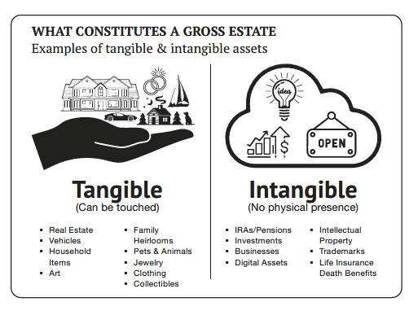
Navigating the Estate Tax Landscape
THE BASICS – NUMBERS TO REMEMBER
Lifetime Exclusion Amount
In 2025 - $13.99 MM per person
Adjusted annually for inflation but also subject to politics
Doubled under Trump; Set to sunset on 1/1/2026 – but will extend
Illinois exemption - $4 million
Annual Exclusion
In 2025 - $19,000 per person/per year
“Freebie” – does not use the coupon to gift
Anything above the annual amount needs to be reported on a gift tax return & is deducted from the lifetime exclusion amount (i.e. uses the coupon)
Portability Available
Must be elected on a timely filed estate tax return (due 9 months after death + 6 month extension)
Or, if only filing for portability, within five (5) years
NO portability at the state level
Portability does not apply to GST-exemption

Slide 14
Use it…or Lose it!
244 Days!
Lifetime Exclusion Amount
In 2025 - $13.99 MM per person - $28.98 MM for a married couple
Add exemption back at time of death to calculate estate tax liability
Excess gifts are essentially grandfathered
In an effort to preserve exemption, “How much?” and “Who?”
Ideally, gift $13.99 MM for each spouse
Should we gift “$7 million each”? – ehhh – not ideal
Or, $13.99 MM by one spouse (or above the hurdle rate) and “$0” by other spouse
“If I can’t gift $13.99 MM now, there is no rush!” – FALSE!
The real benefit of gifting is to gift the current value and the future appreciation
$1 MM gift to Harrison this year…in 10 years, valued at $2 MM…in 20 years, valued at $4 MM
Clients should NOT WAIT!

Slide 15
Benefits of Gifting in Trust

Slide 16
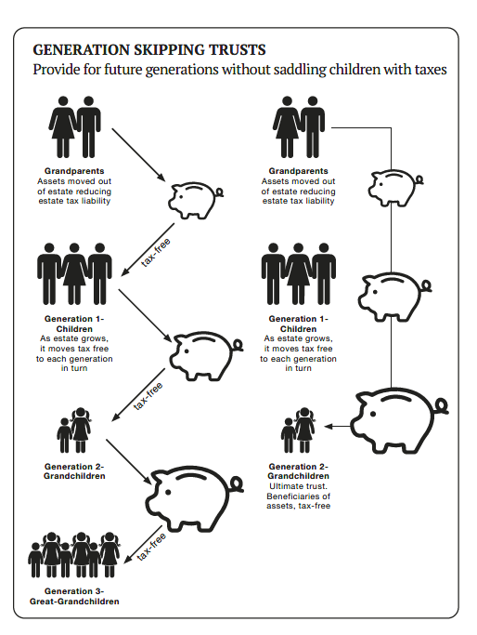
Benefits of Gifting in Trust
Asset protection for beneficiaries
“Intentionally Defective Grantor Trusts”
All income tax attributes flow back to the grantor
Income tax payments are not “gifts”, but rather a freebie
Reduce value of parents’ estate - allow money to grow outside of estate
GST-Exempt Planning
Generation skipping transfer tax planning
Transfer wealth from generation to generation estate tax free
Discounting
Use business interest to take discounts - lack of marketability / control

Slide 17
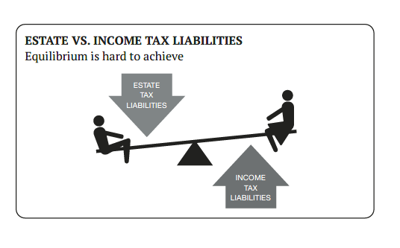
Drawback of Gifting in Trust

Slide 18
Impact of Gifting – State of Illinois

Slide 19
Impact of Gifting in State of Illinois
Illinois estate tax exemption - $4,000,000
No Illinois gift tax
No portability at the state level
Benefit of gifting the current value plus appreciation

Slide 20
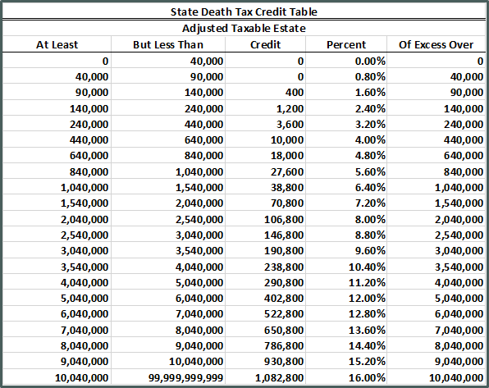
Illinois - Graduated Estate Tax Rates
You pay taxes on entire estate if estate is above $4 million
Illinois estate tax rates start at 28.5% and taper off to 10%

Slide 21
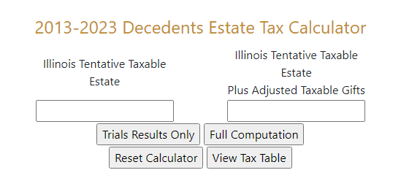
Illinois Attorney General Estate Tax Calculator
35 ILCS 405/2 – Illinois’ formula selects the lower of either: 1) the “2011 calculation” under former Section 2011 of the Internal Revenue Code (“IRC”); or 2) the “hypothetical tax” based on federal estate taxes reckoned with a $4 million estate tax exclusion amount.

Slide 22
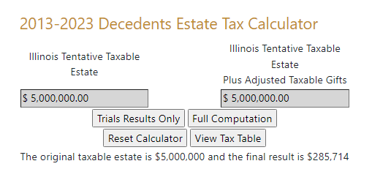
Benefits of Making Lifetime Gifts
Example: Riley has estate worth $5,000,000
Made no gifts
Illinois estate tax due: $285,714

Slide 23
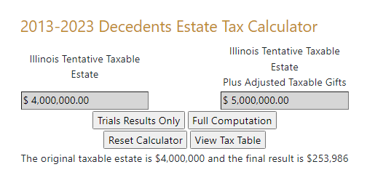
Lifetime Gifts Saves ~10% Illinois Estate Tax
Example: Riley has estate worth $5,000,000
Lifetime gifting of $1,000,000
Illinois estate tax due: $253,986 (savings of $31,728)

Slide 24
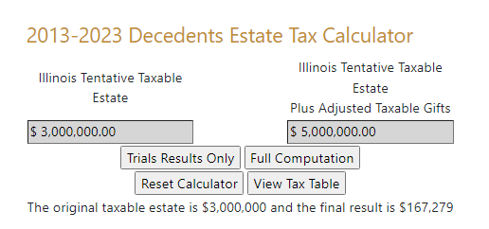
More Gifting = More Estate Tax Savings
Example: Riley has estate worth $5,000,000
Lifetime gifting of $2,000,000
Illinois estate tax due: $167,279 (savings of $118,435)

Slide 25
Take Aways

Slide 26
Take Aways – Taxes & Estate Planning
Not all trusts are created equal – the terms of the trust can vary dramatically – the revocable living trust needs to be properly drafted to provide asset protection and wealth transfer tax planning benefits.
Funding / balancing is “key” – don’t just have a plan that is “fine” – save the $400,000!
Illinois is an expensive place to die – the exemption / tax free amount is only $4 million and the effective tax rate can be 28.5%
Federal exemption / tax free amount is $13.99 – 2026 – TBC
If you have a lot of money, GIFT NOW – USE IT – or LOSE IT! Gift $13.99 million before the exemption drops
Estate tax planning is often overlooked…everyone focuses on income taxes (rate of 23.8%) vs estate taxes (rate of 50%!)
Taxes & Estate Planning

Slide 27
Thank you. Questions?
Lindsey Paige Markus
312.855.6417
Lmarkus@chuhak.com

